Slide 1
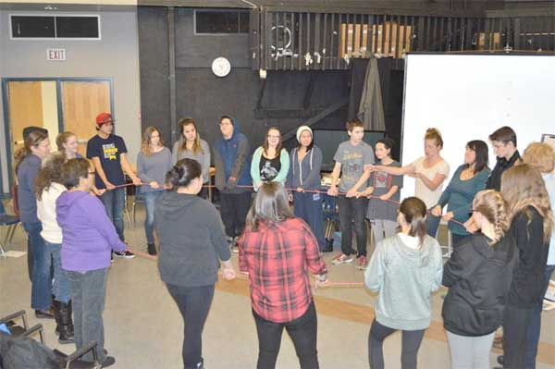
Youth for Safety and Justice
Community based program
May 2016

Slide 2
Youth for safety project in Watson lake
Watson Lake Secondary School in partnership with community agencies have embarked on a three-year Youth-led learning project called “Youth for Safety” (YFS).
YFS is based on learning topics of safety, dignity, justice, and violence against girls and women; it explores how men keep women safe and how women stay safe.
There will be a total of five two-day workshops from January to May 2016.
All workshops will be in the class room and will explore about topics in an interactive way and using youth-led projects to address different aspects of safety in Watson Lake. Youth will propose and work on annual projects of their choice to increase safety in their community.

Slide 3
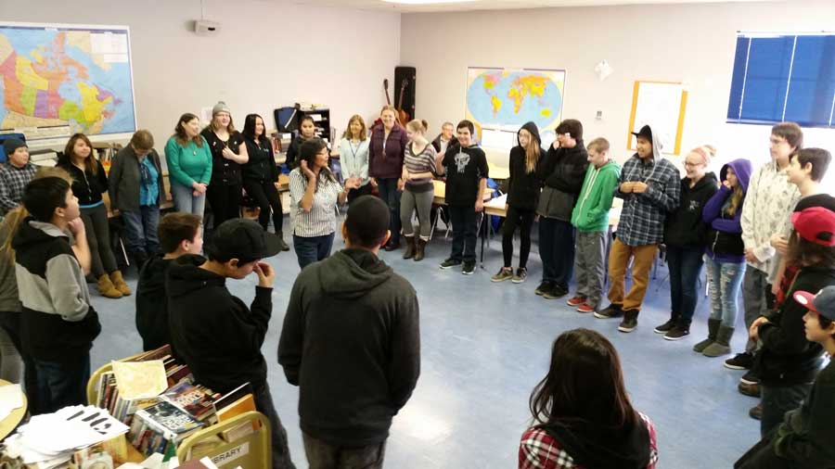

Slide 4
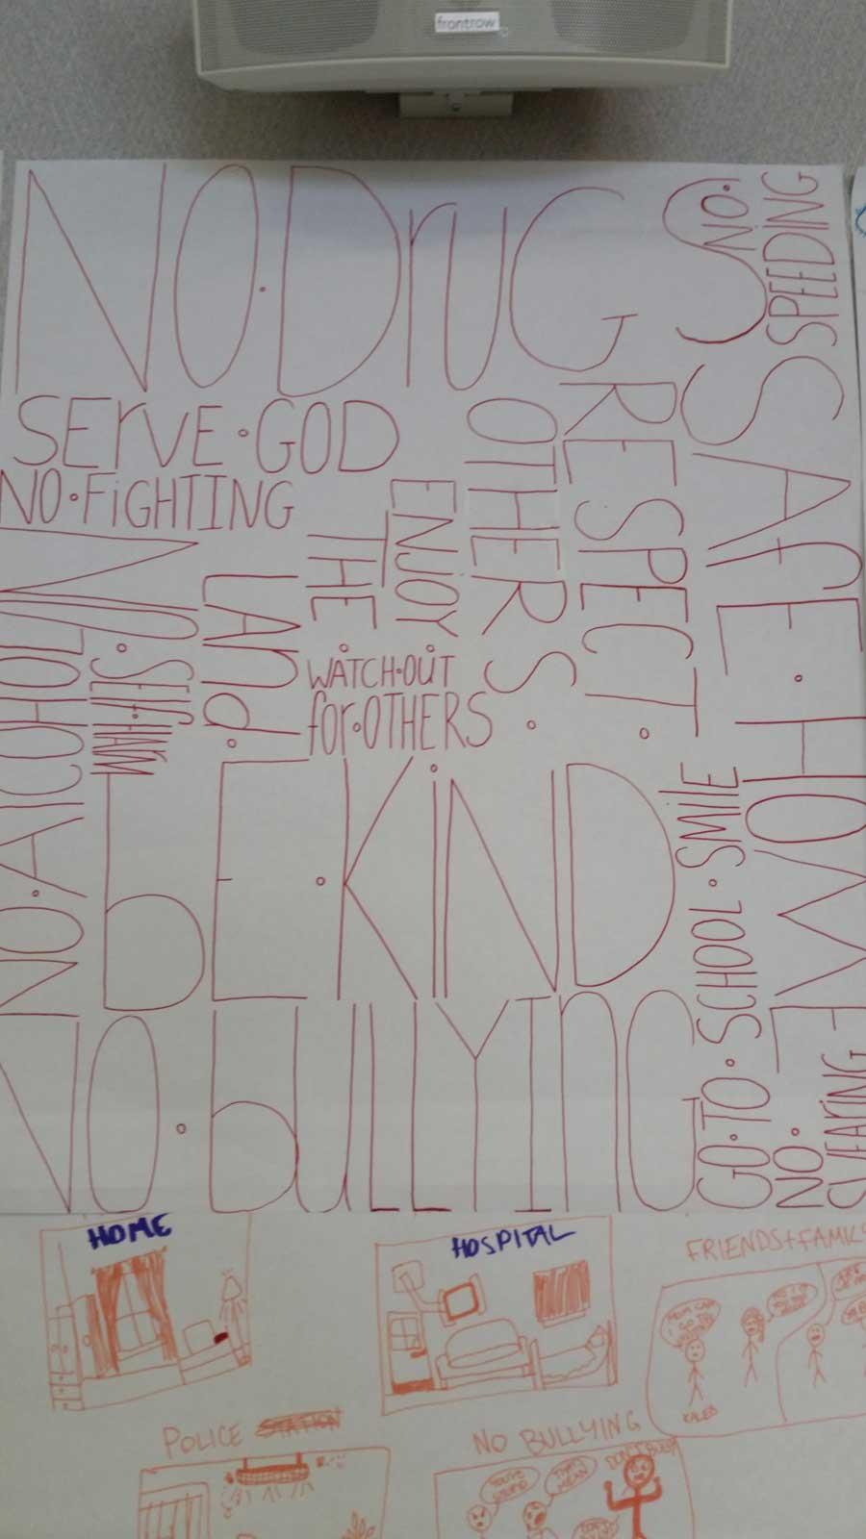

Slide 5
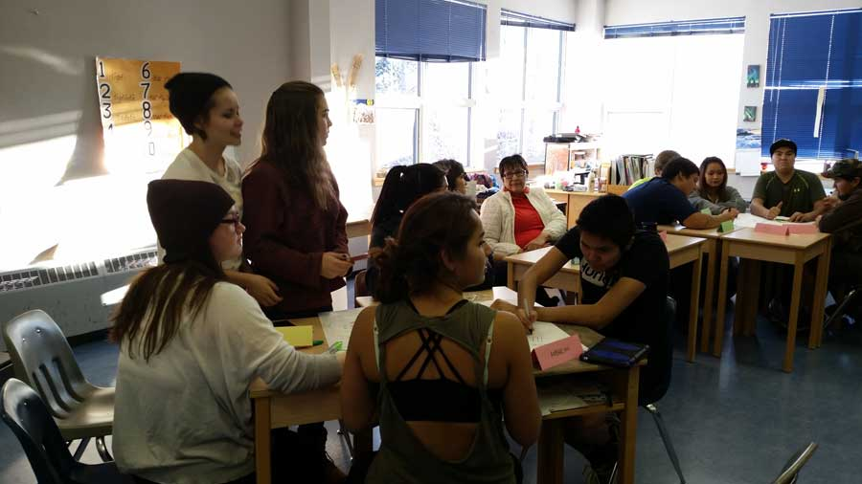

Slide 6
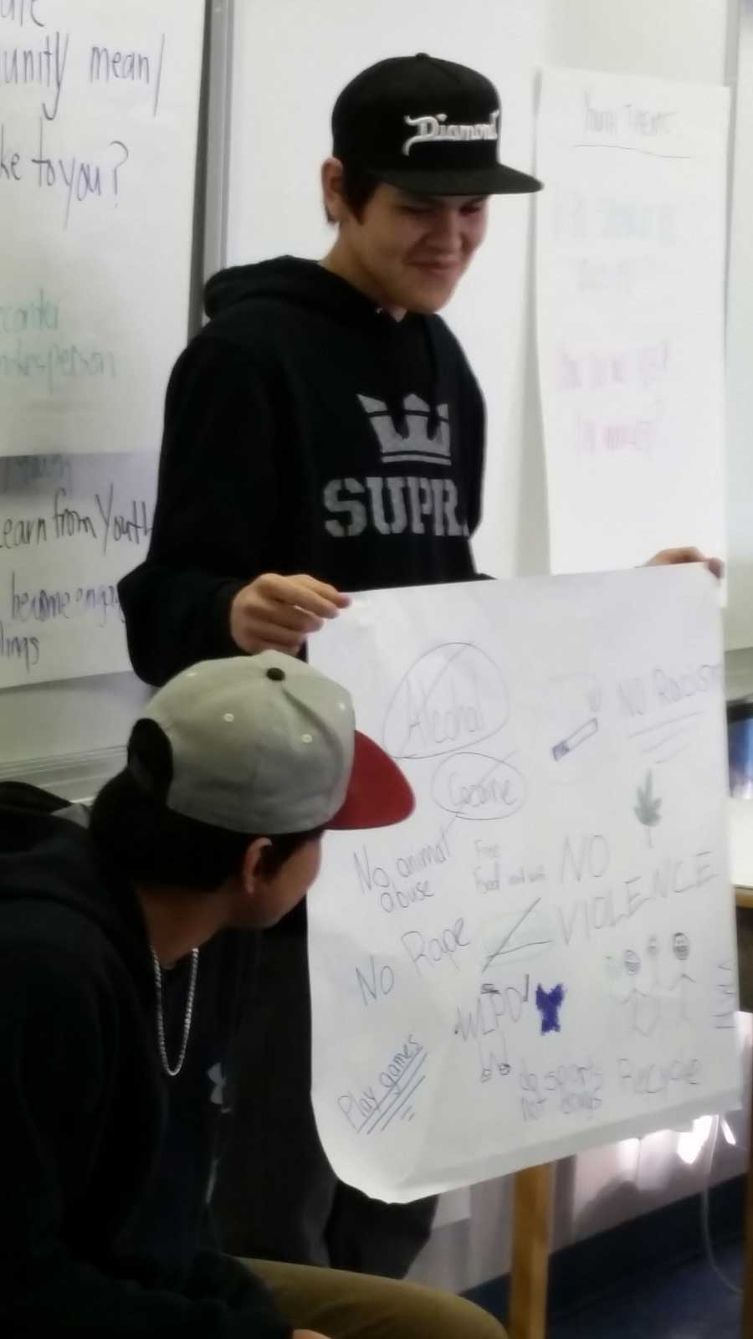

Slide 7
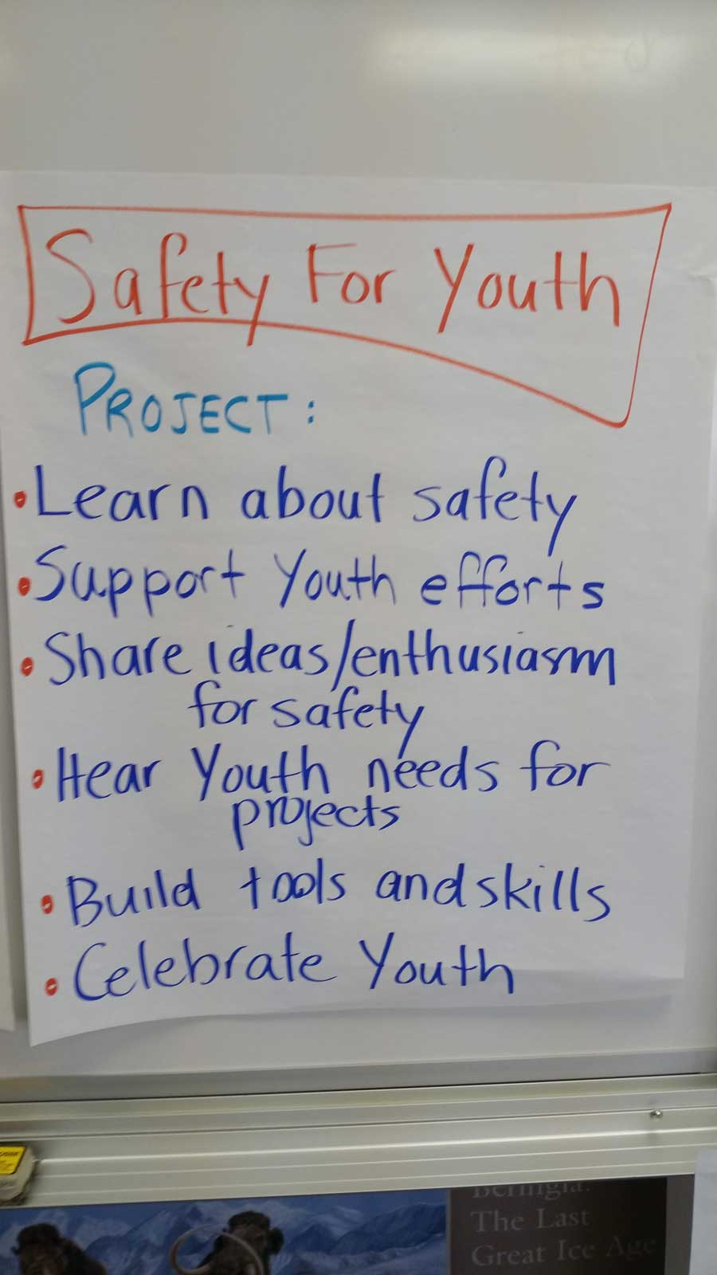

Slide 8
Youth for safety project in Watson lake
Youth for Safety and Justice is a youth empowerment project designed to foster community safety and justice for young women and girls.
Designed to provide youth with the knowledge and skills needed to assume a leadership role in promoting safety and justice for young women and girls
Community youth will participate in learning and applying knowledge and skills in community safety and justice for young women and girls, youth advocacy, peer support and community social action
Project utilizes principles of Response-based Practice

Slide 9
Awareness of gendered violence
Privilege
Relationship building
Dignity
February
Dr. Allan Wade workshop
Power of language
Implement survey
January
Brainstorming
Awareness of sexualized violence
oppression
campaign plans
Gender
March
Campaign work
addictions
SHOWCASE OUR HARDWORK!
April
sexuality
Celebration
Work plans developed
Topics covered
May
Addiction

Slide 10
January Workshop
The launch of the project happened on January 21st, 2016 at WLSS in Watson Lake, Yukon.
  The main focus of the first workshop was to build relationship
  to explore topics of safety and dignity
  start planting seeds about prevalent social justice issues to inform their campaigns

Slide 11
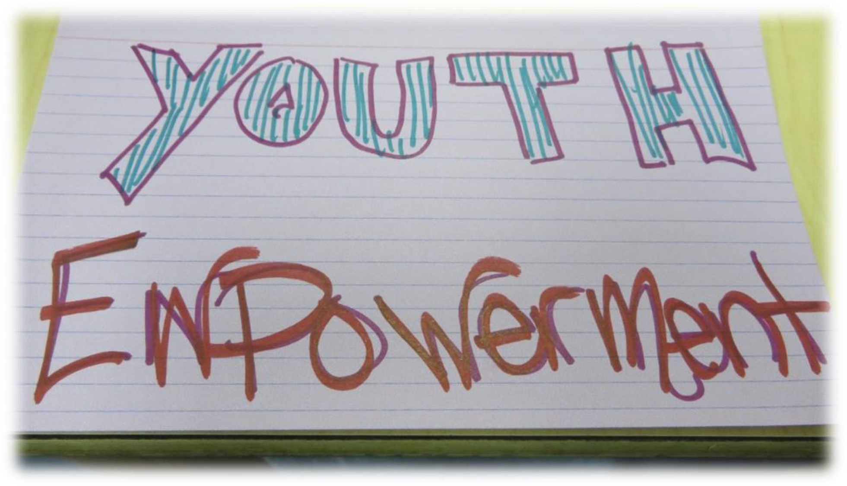

Slide 12
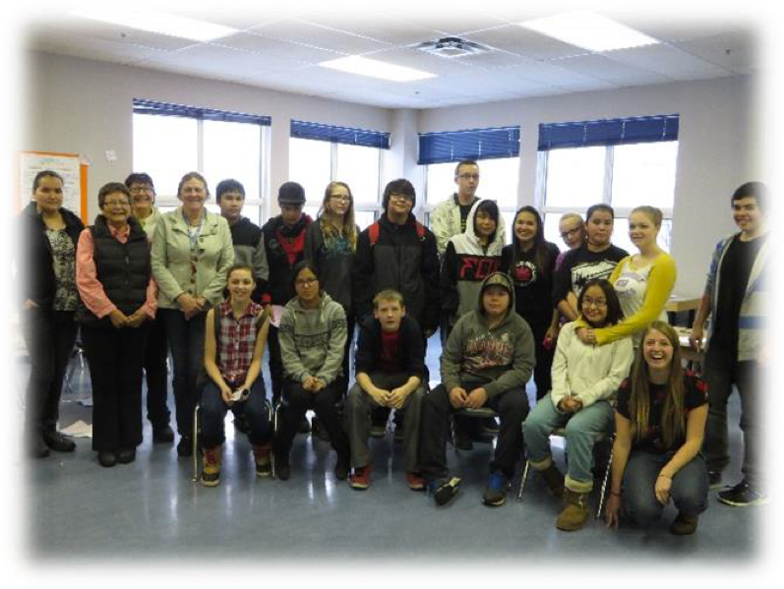

Slide 13
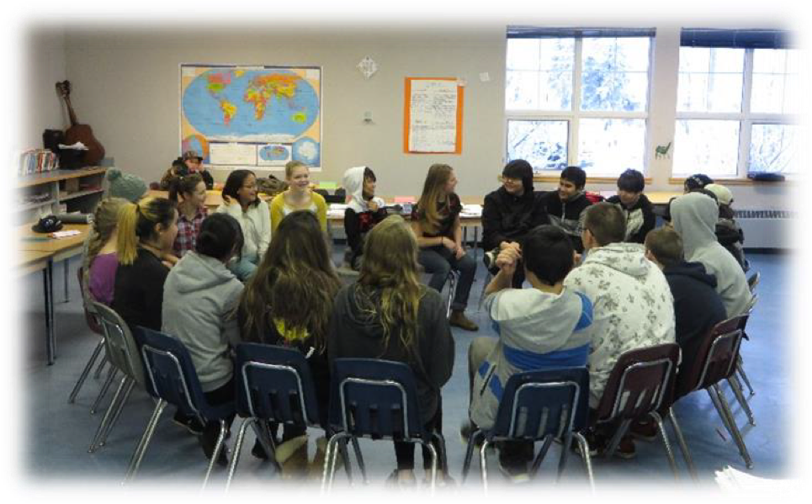

Slide 14
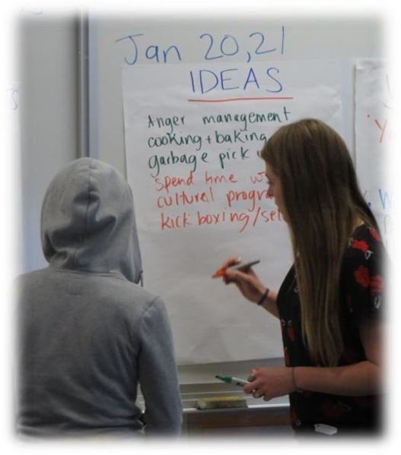

Slide 15
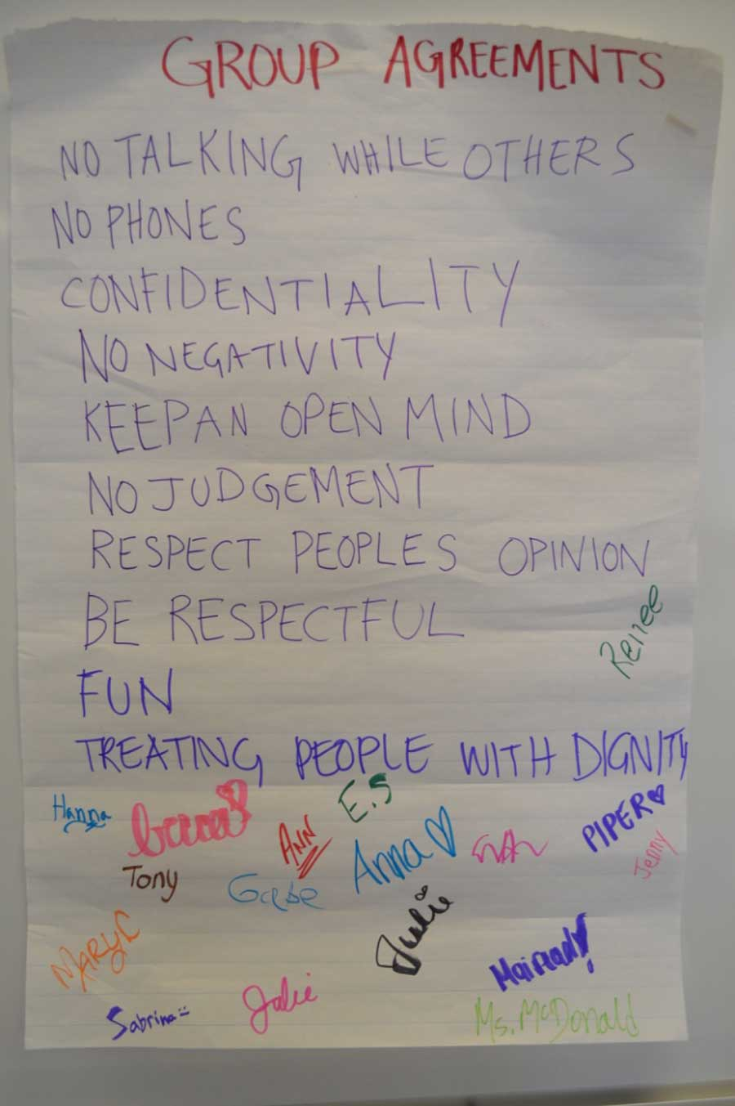

Slide 16
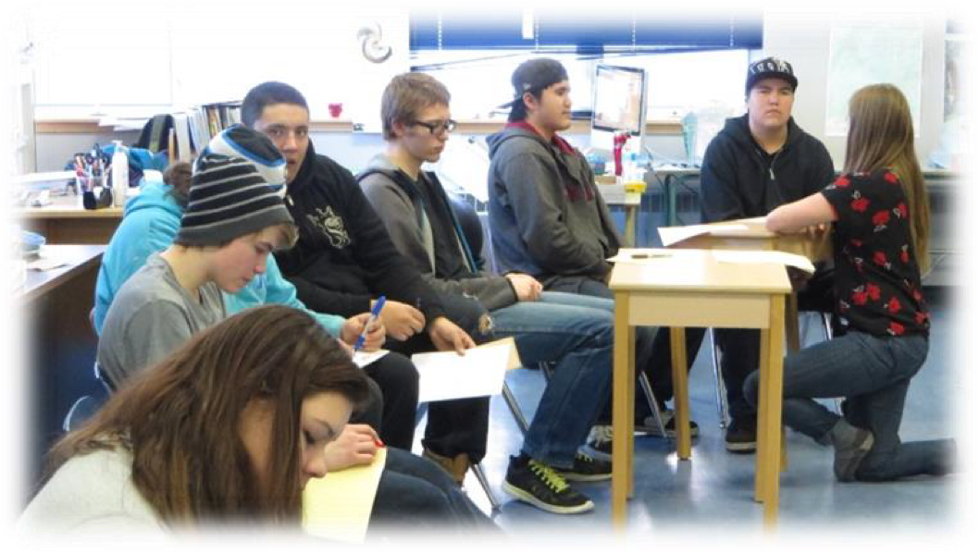

Slide 17
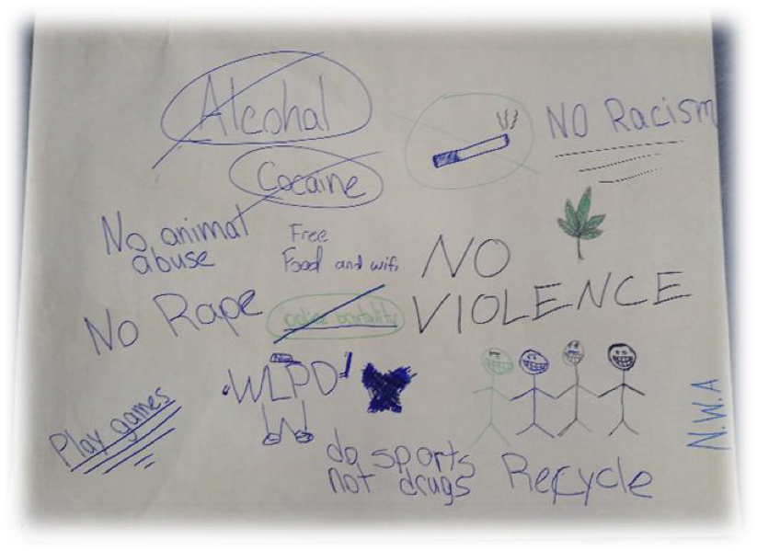

Slide 18
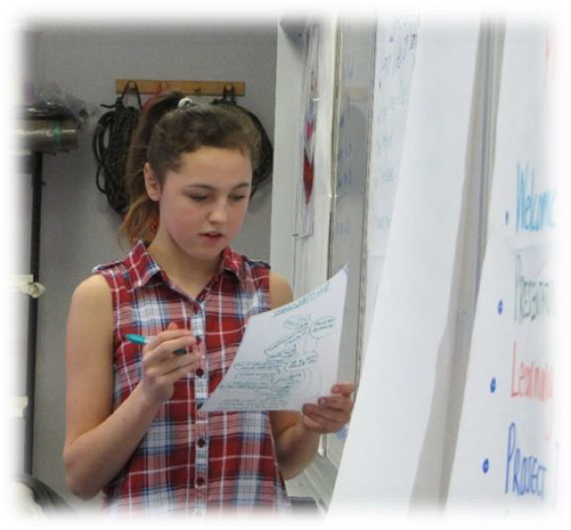

Slide 19
February Workshop
The February workshop was focused on building a foundation of awareness with the youth around sexualized violence and other social justice issues.
  This was achieved with a mixed-methodology: using captivating and educational awareness videos, a quiz to get a sense of what the students already knew and give them an idea of statistics surrounding gendered violence,
  Large and small groups discussions, workshop delivered by Dr. Allan Wade on resistance and language around sexualized violence and violence towards children.

Slide 20
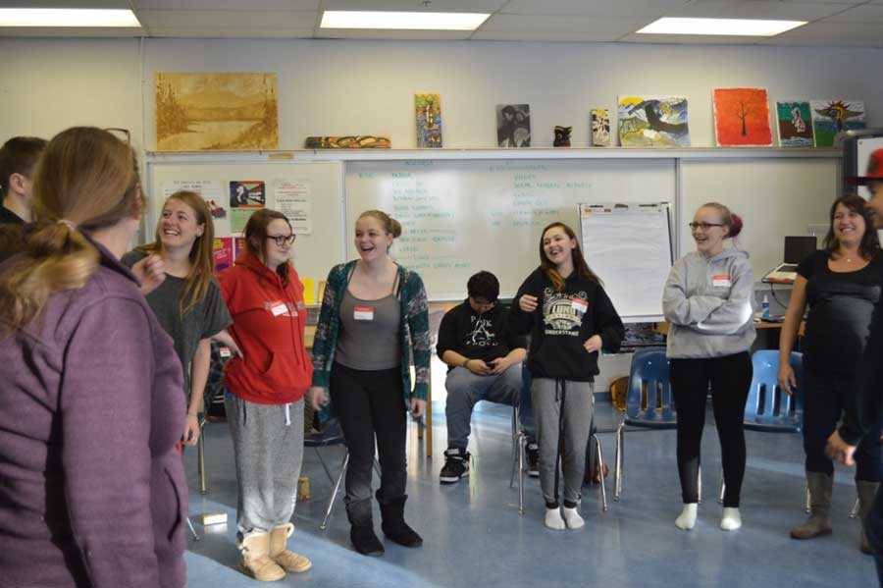

Slide 21
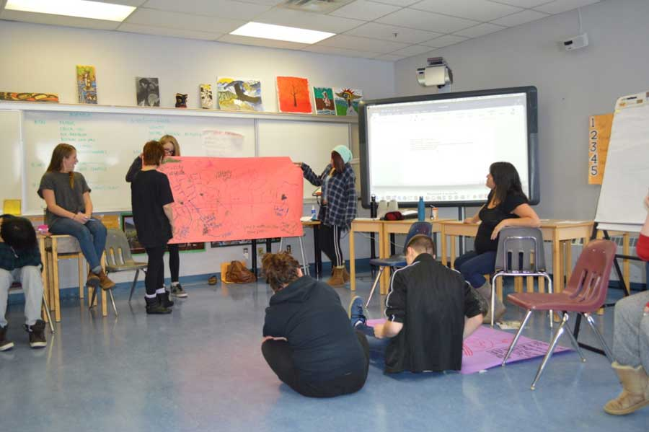

Slide 22
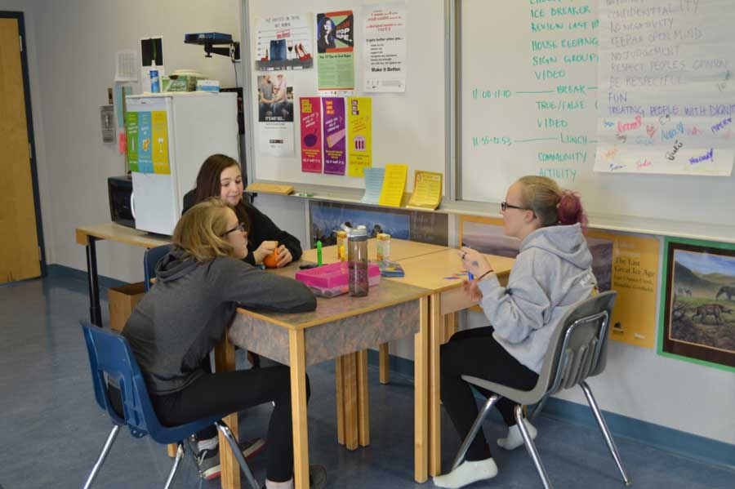

Slide 23
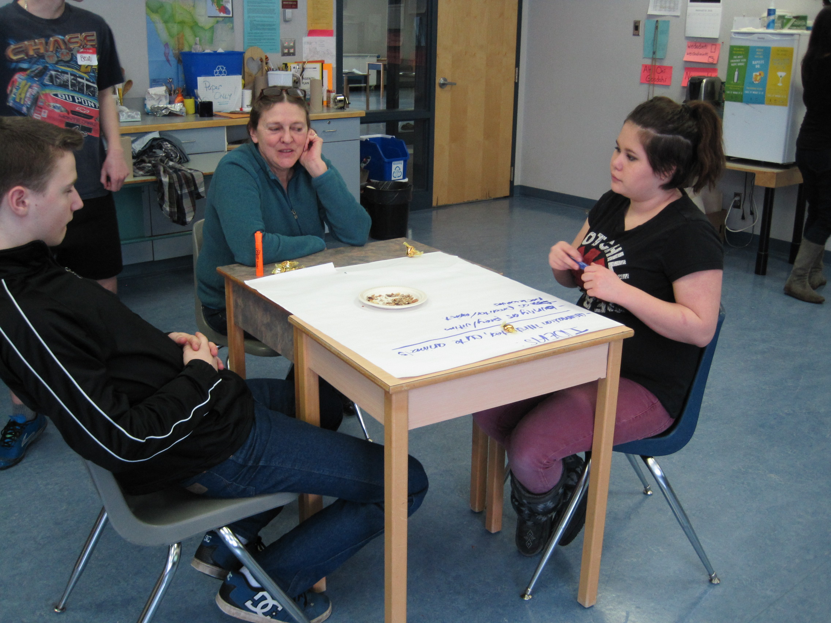

Slide 24
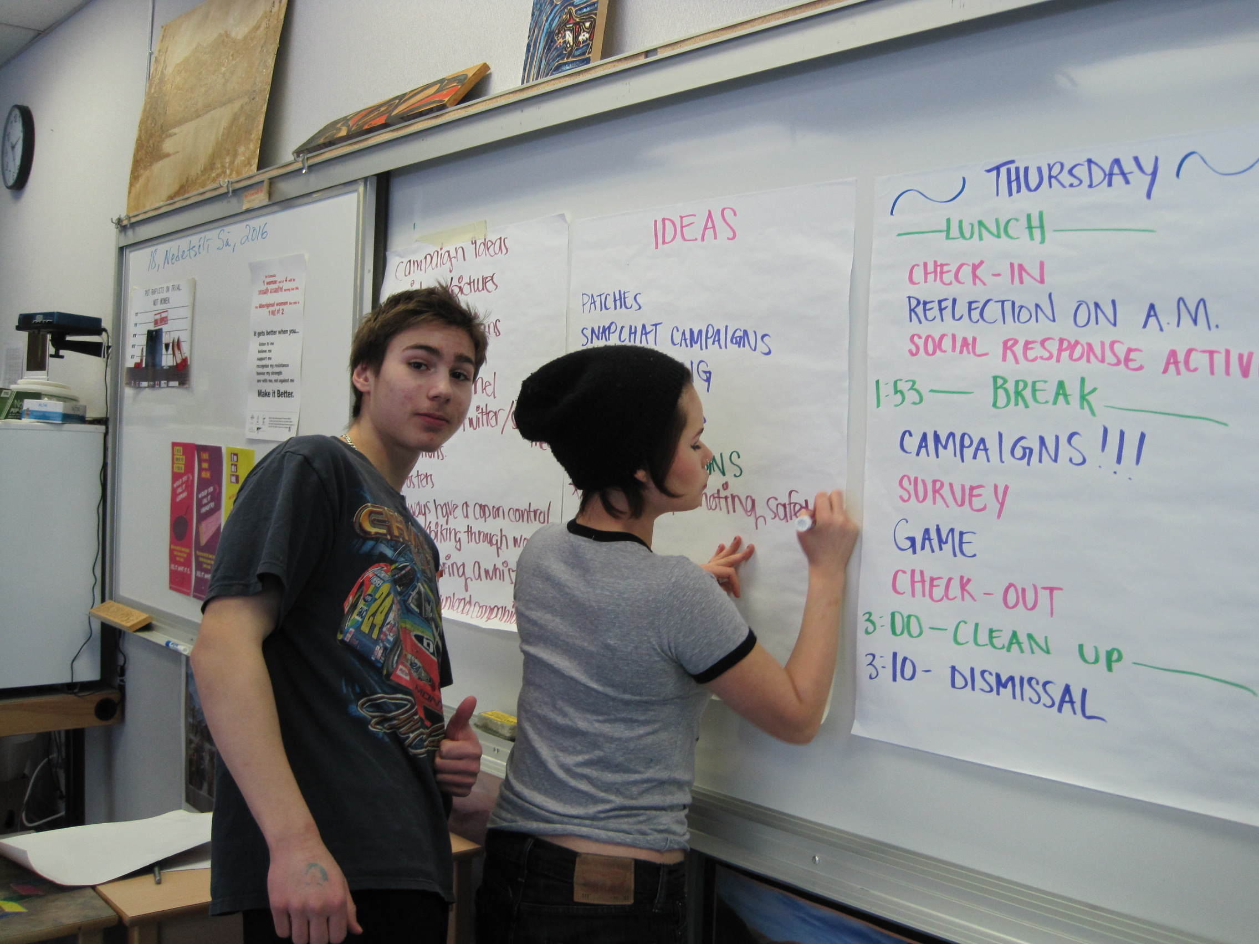

Slide 25
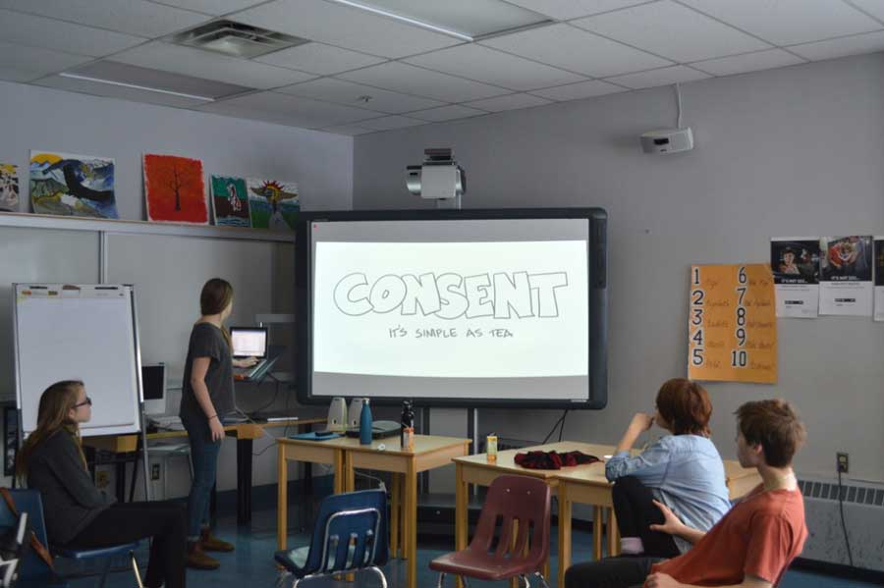

Slide 26
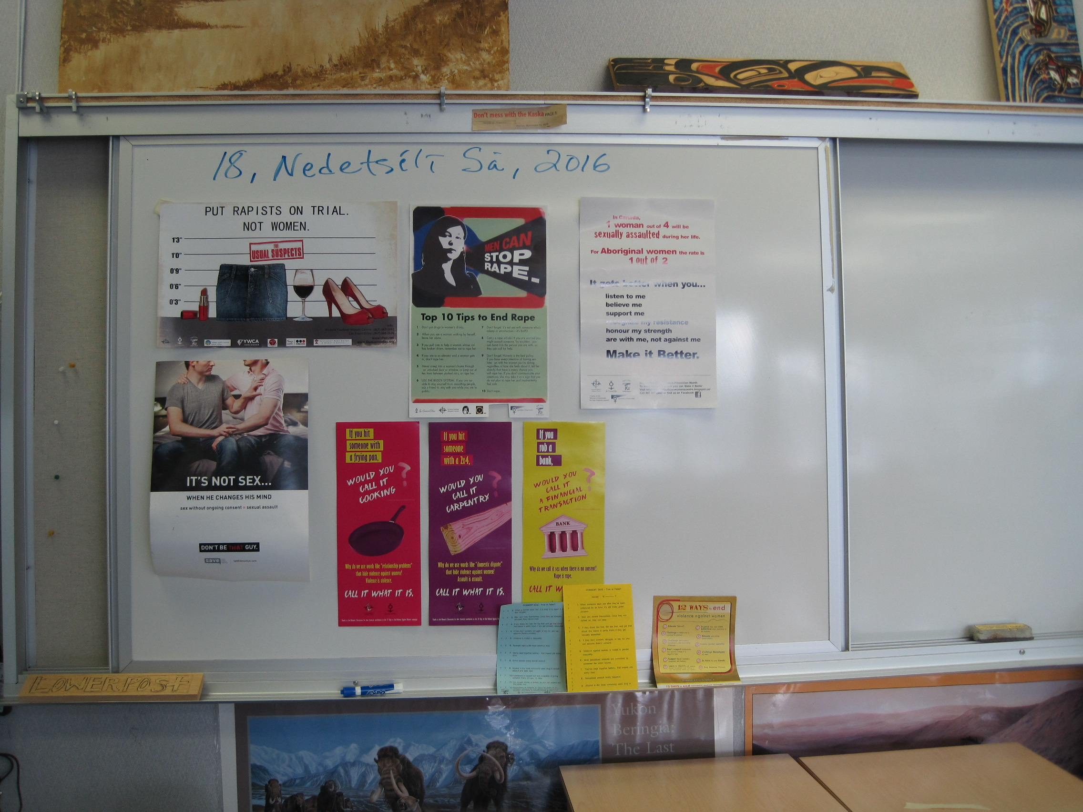

Slide 27
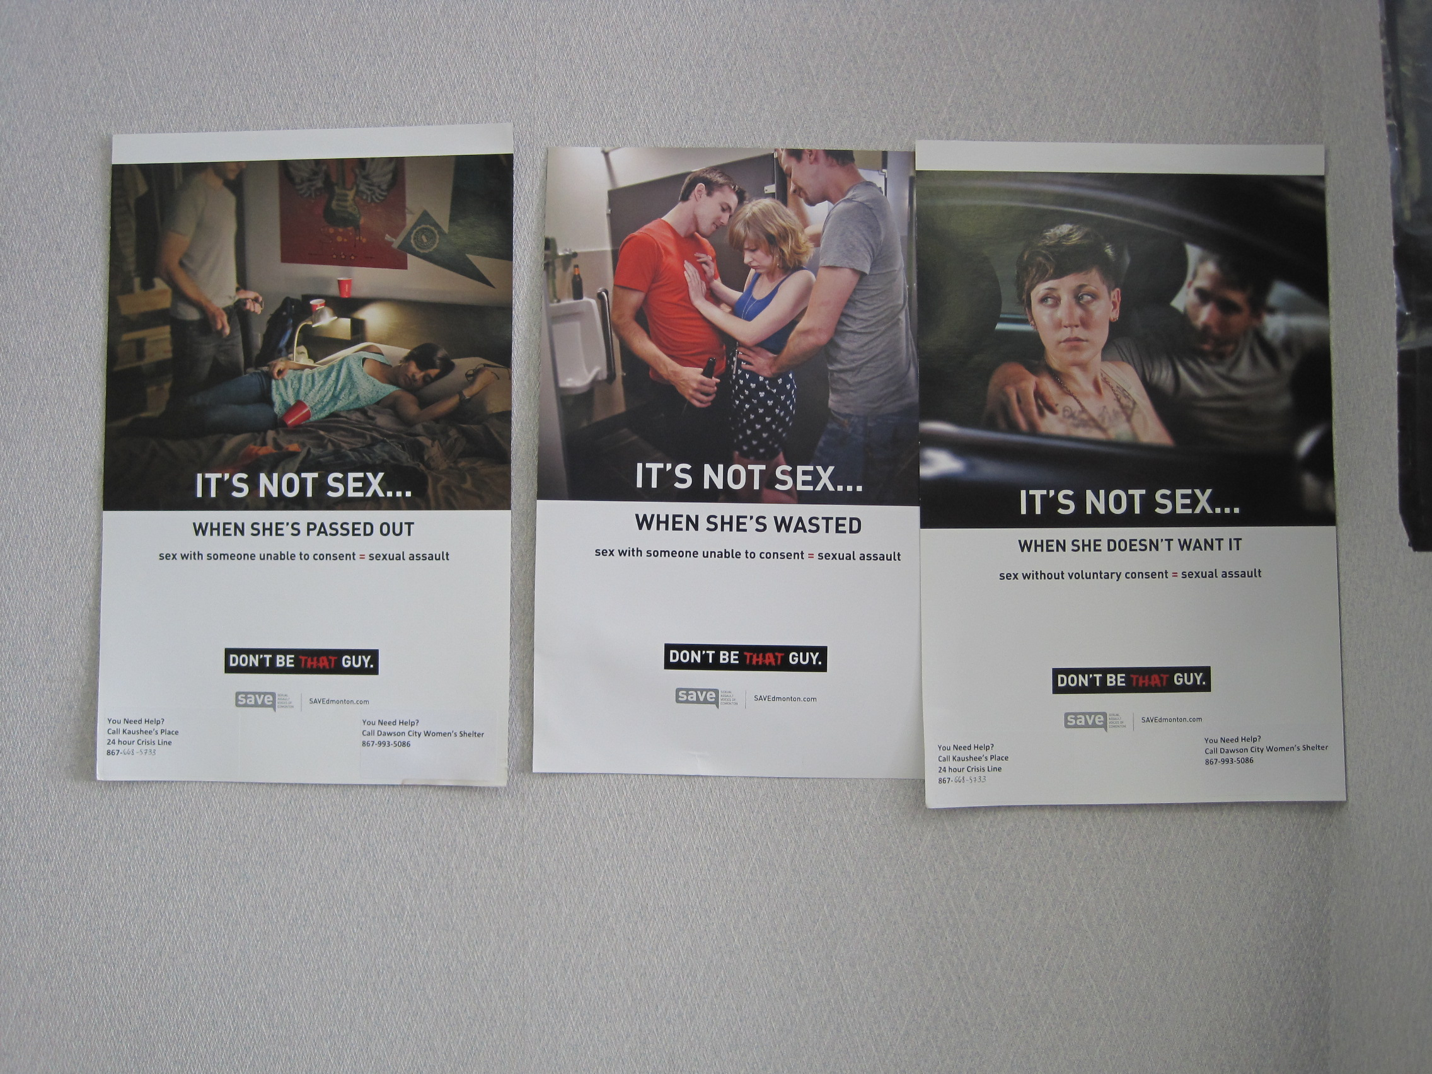

Slide 28
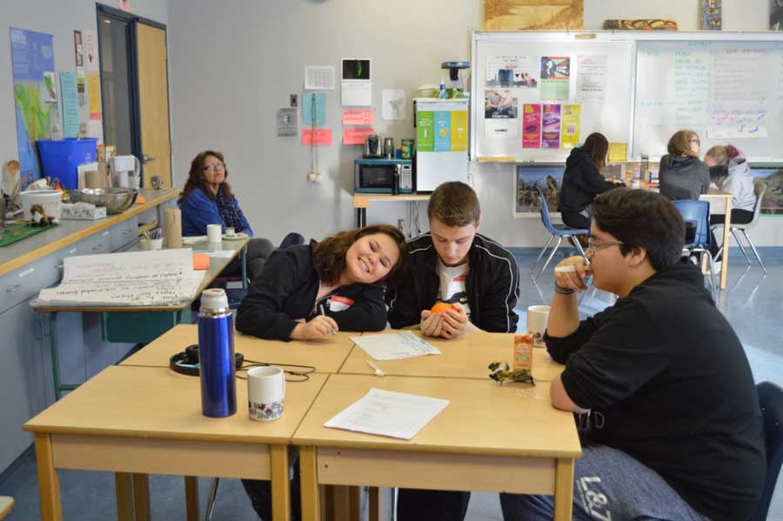

Slide 29
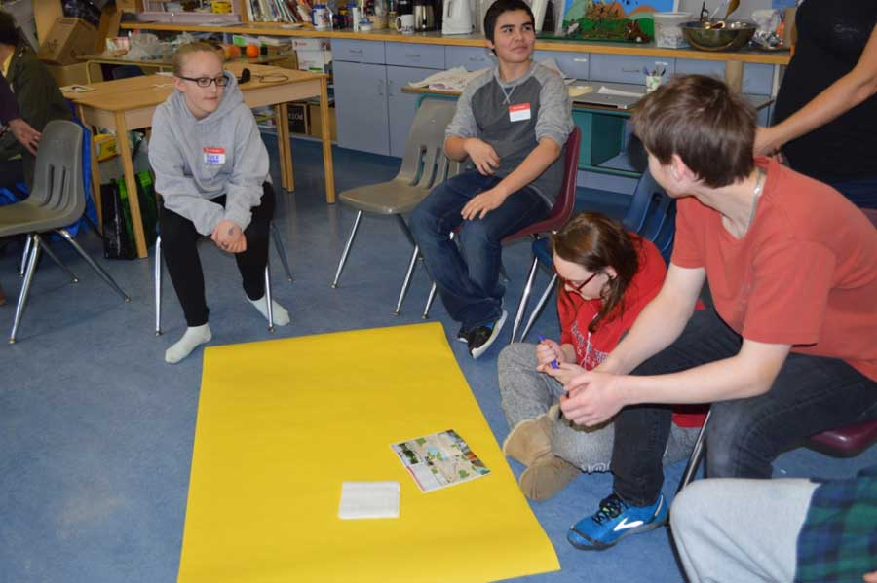

Slide 30
March Workshop
The March workshop was focused on building on that foundation of awareness around sexualized violence and other social justice issues, with a focus on positive and negative social Responses
  Discussion on gender and sexuality (as requested on a youth survey).
  A goal of talking about social responses is that youth will feel more prepared on how to talk to victims of violence in a supportive and healing way.
  Another main focus was narrowing down campaign ideas and beginning to develop those campaigns. In addition, facilitators introduced how to put together a press and media release to spread the message of the campaigns, a practical skill that the youth can use in the future.

Slide 31
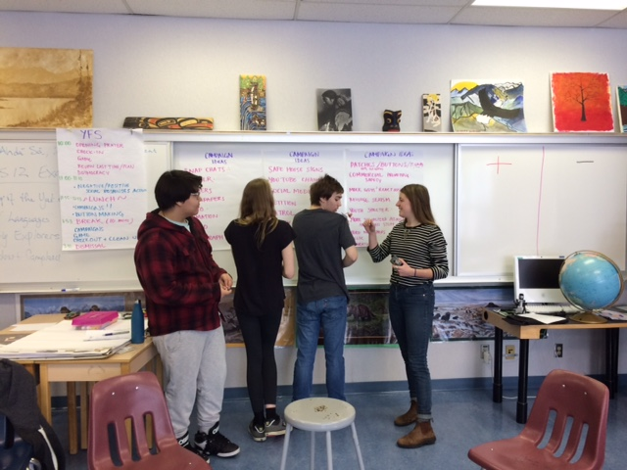

Slide 32
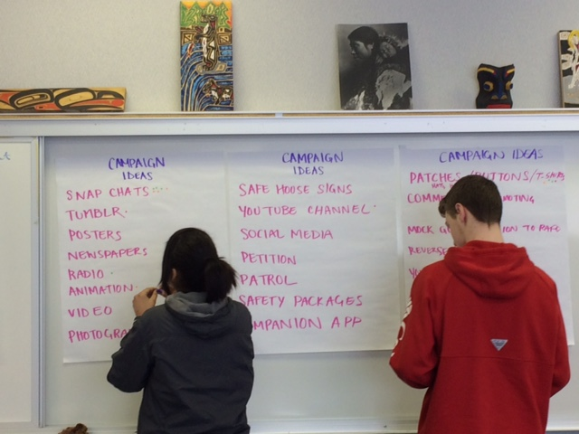

Slide 33
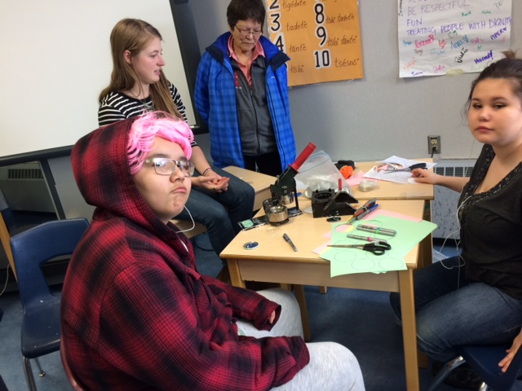

Slide 34
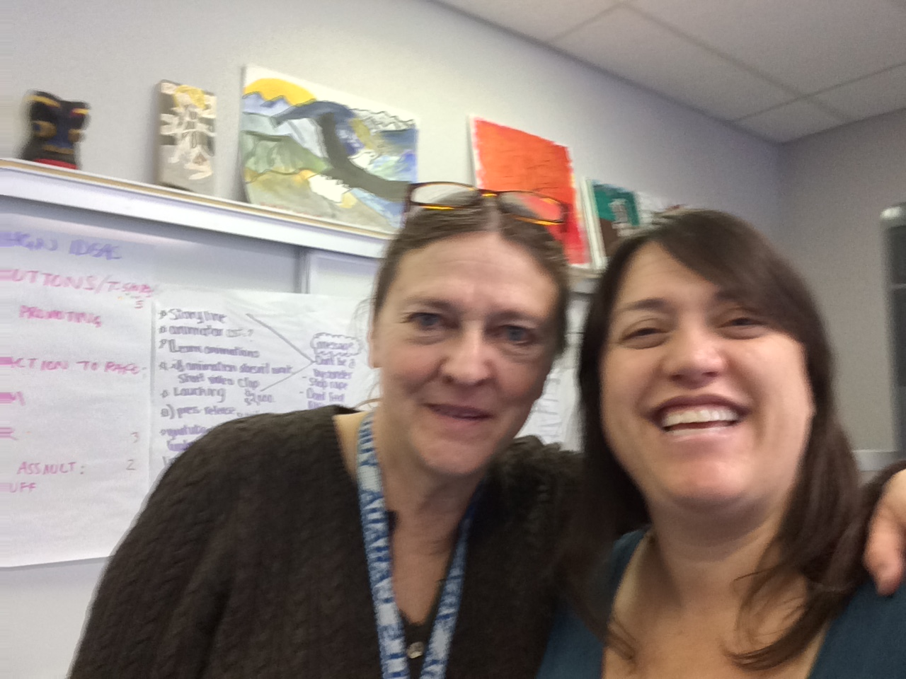

Slide 35
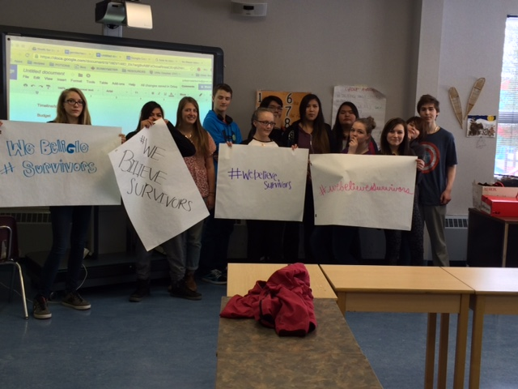

Slide 36
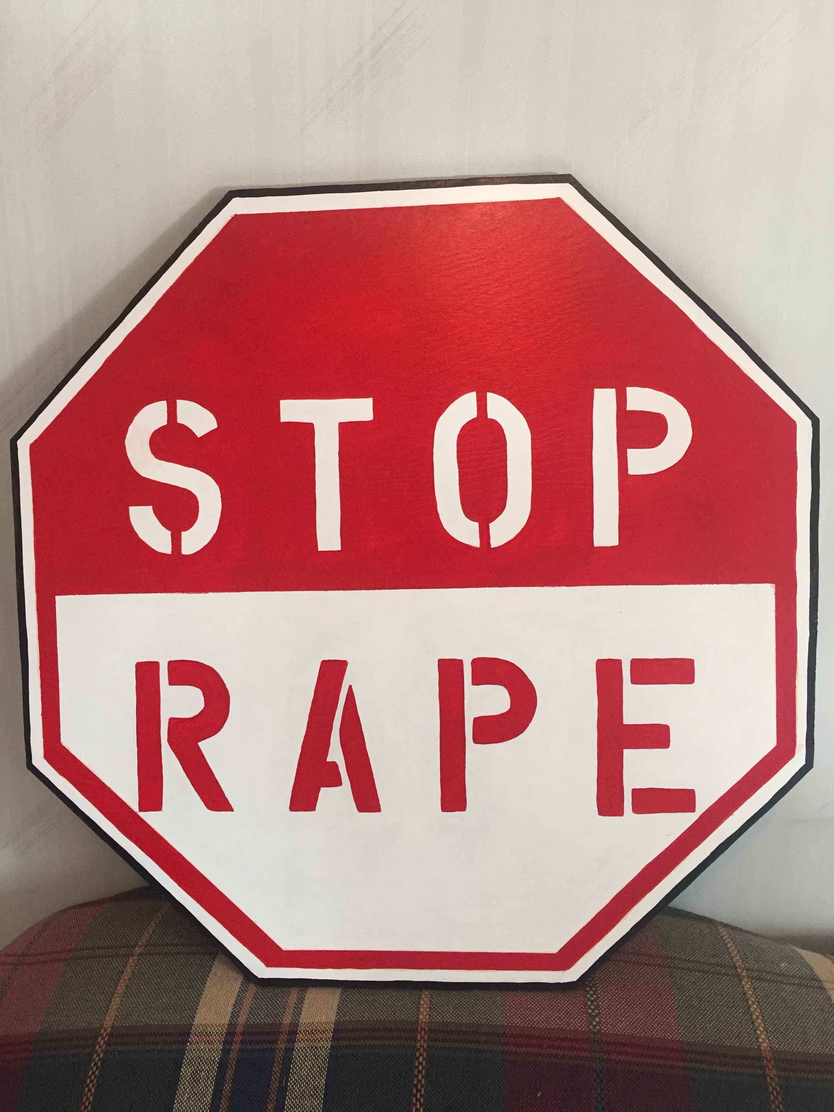
Youth For Safety Campaigns
Petition to change the mutualizing language used in within the Canadian Justice System
Button making to bring awareness to sexualized violence
”Stop Rape” sign for signpost forest
Graffiti with messages around consent
Community awareness night

Slide 37
Thank you to the elders, community agencies, members, youth , facilitators, guest speakers and teachers for what you have offered to the Youth for Safety Project
We look forward to the continuation of this three year project!

Slide 38
